Slide 1
SMART INDIA HACKATHON 2018
ARYA COLLEGE OF ENGG. & IT.
Team name: Titanic submitted by:-
Sindhu santoria
Neha patel
Jyoti kumari

Slide 2
PROBLEM STATEMENTS
ARIES
Closed loop irrigation solution for farmers:
Irrigating field plays a vital role in crop yield.
However, how much and when to irrigate is still
Moderated by the traditional knowledge for the farmers, knowing how much water is actually required for a given crop for a particular soil type depends majority on soils capacity to hold moisture.
we need in IOT ,AI based solution which can auto irrigate the field for a given crop based on the soil moisture content.

Slide 3
SOLUTION
Automatic irrigation water supply monitoring and control system.

Slide 4
COMPONENT USED
1:-8051 microcontroller
2:-Power supply
3:-16*2 liquid crystal display
4:-DC motor
5:-DC motor driver
6:-Soil moisture sensor

Slide 5
ABSTRACT:-
Abstract:-
At present ,labor-saving technology is a key issue
in irrigation .People now are working actively at
Intelligent irrigation system because of their
Advantages of laborsaving and water saving .the
Present project describes a design of low-cost
Irrigation system.
The system consist of micro controller (8051),soil
Moisturizing sensor collects the air humidity
Parameters and sends it to the microcontroller.
If the humidity values are low, microcontroller turns on the
Motor ,to supply water the crops .
If the humidity values are high ,microcontroller turns off the motor ,
To stop the supply water to the crops. These status are display on
The LCD.
This project uses regulated 5V,500mA power supply ,
7805 three terminal voltage regulator is used for voltage regulation
Bridge type full wave rectifier is used,and the AC output of secondary
230/12V step down transformer .

Slide 6
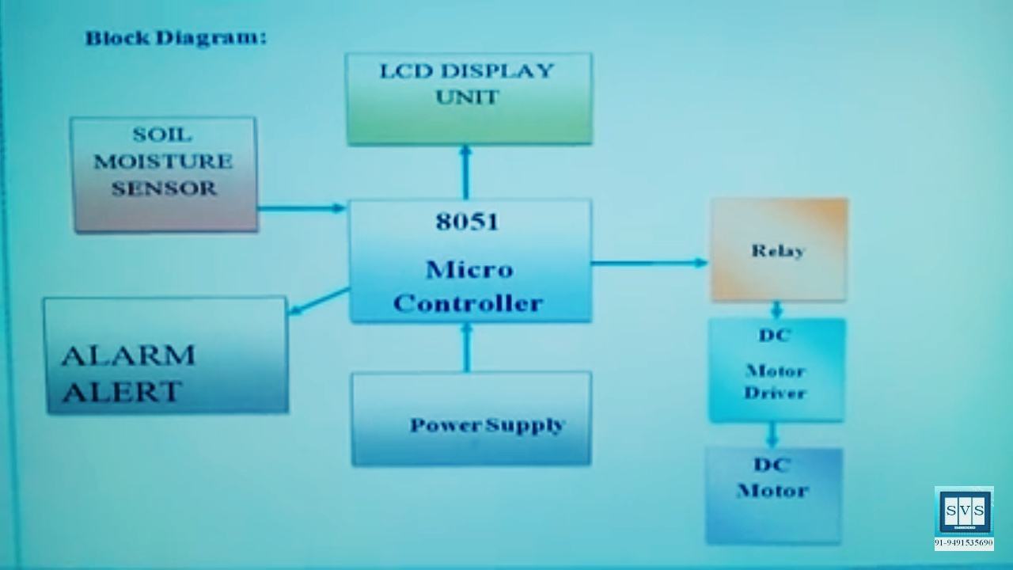
BLOCKED DIAGRAM

Slide 7
WORKING
We are using the soil moisture sensor that will sense the amount of moisture contained in the soil, along with the 230 V input step down transformer with 9v output AC to operate the relays .Now this AC supply is given to bridge rectifier, which is converting AC to DC. Now we have to extract the pure DC for which we are using 1000mf electrolytic capacitor .we are also using the LED which will glow when the power supply will be given .Here 8 bit microprocessor and 32 pin IC is also connected with the LCD , which will display the whole process in the form of instruction The 11.1 MHZ crystal is used to run the program . Amplifier is also used to amplify the signal.

Slide 8
When the power supply is given ,then if there will no moisture in the soil , then the sensor will sense and the message will display on LCD that “there is no water in the field , switch ON the motor ”,and buzzer will sound to give the signal . Now when the requirements of water is full-filled , then the moisture will be sensed by sensor and buzzer will again give the signal and also the message will display on the LCD that “there is enough water in the field , turn off the motor ”. After the two signals by the buzzer ,the famer have to switch off the motor
This will enable the farmer to turn ON & turn OFF the motor while staying at home and need to go to the field.

Slide 9
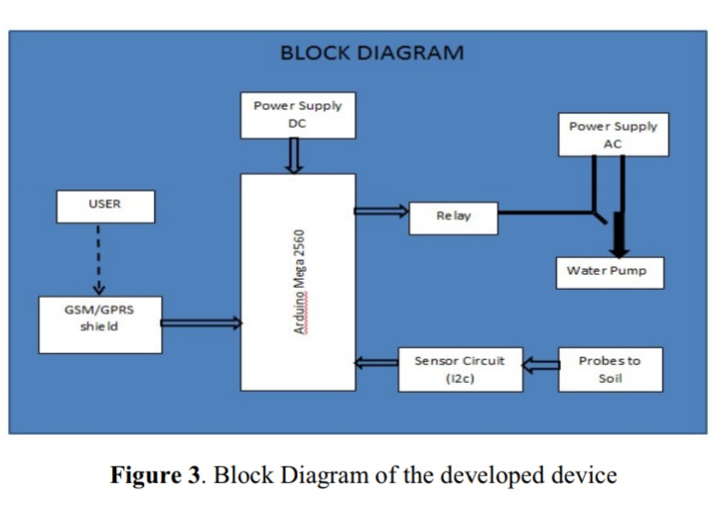

Slide 10
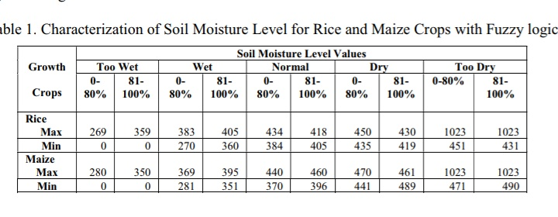

Slide 11
conclusion
This project aims automatic water irrigation system ,which enables the farmers to control the irrigation while staying at home .They don’t need to go in their field to mange the water supply to their fields which not only saves their time and energy but also the wastage of water , as water saving is one of the vital concern to think about

Slide 12
THANKS

